Slide 1

Mortality causes in Mexico
By Vanessa Guzman

Slide 2
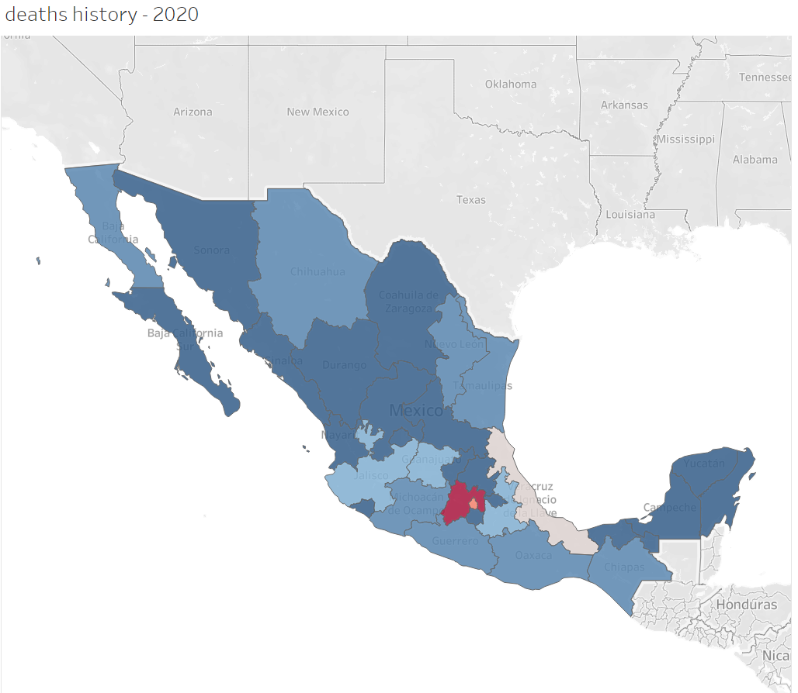
Project overview
The importance of knowing the causes of mortality in a country is because they help us to analyze and design better programs, implement improvements and evaluate the health system.
Since 2020, COVID-19 became a major threat in Mexico. With this in mind, one of the goals of this project is to publicize the impact it had on the Mexican population.

Slide 3
Data
Use microdata of death records from the National Institute of Statistics and Geography (known in Spanish as INEGI).
Data has a star model and were originally stored as dbf.
Data Engineering:
Convert dbf files into CSV (Automated process)
Clean data, getting new dataframes by merging tables.
Create new columns to transform the data into readable information.
Slice the original database to keep only the important columns for this project. Store data into SQL

Slide 4

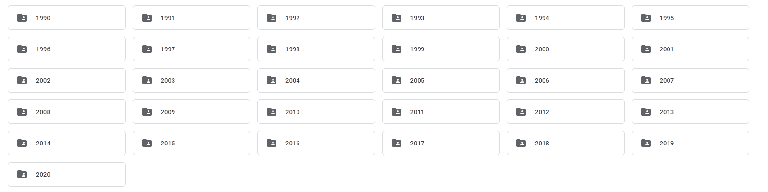



Get data from INEGI
MortalityDataEngineering.ipynb
Order it in a easy to handle way
(data size restrictions, 4.6M records!!!).
Data transformation
Data Handling.ipynb
Machine Learning Model
Multiclass Logistic Regression
Linear Regression

Slide 5


Front-end
Create a HTML/CSS
Use Tableau to create dashboards with charts inside the app.
Upload templates, CSS and JS into AWS

Slide 6
Results
Go to app

Slide 7
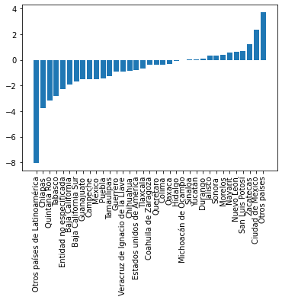

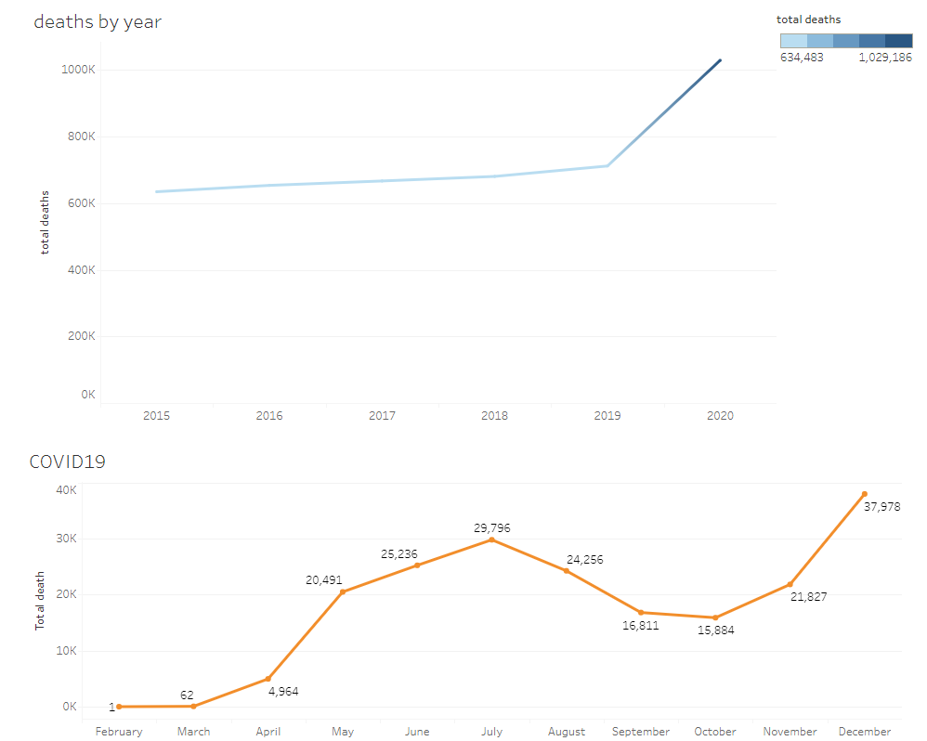

Where you live matters for L.E.
Huge excess mortality in 2020 (over 300K people!)

